Slide 1
Transportation Services Report and TCCAP Update
March 5, 2014

Slide 2
Transportation Services Update
Route Operations:
2808 Students transported
441 Students ineligible
16,916 KMs day
57 School Bus Routes
37 Board operated
20 Contracted routes
Operated by 11 contractors
GYPSD Driver’s:
37 Regular drivers
19 Spare drivers
48 Class 4 drivers
Transportation Fleet:
37 Buses assigned to regular routes
10 Spare buses
6 Transportation vehicles
4 MFV
21 Facilities vehicles
4 Technology vehicles
Current Projects:
Refresher Training
Q Endorsement (Air Brakes)
Cooperative Bussing Agreements
Website updates
Safety
School Bus Safety Awareness
Alberta Traffic Safety
School Bus Driver Recruitment
Provincial School Bus Road-e-o

Slide 3
In October of 2011 the Transportation Community Consultation Action Plan (TCCAP) was approved by the Board of Trustees to outline the process in which Grande Yellowhead will engage their internal and external stakeholders regarding their current needs, or transportation concerns. The core belief of the Board of Trustees is that all concerns will be reviewed in the best interests of our students with regards to the impact on their education.

Slide 4
TCCAP
Grande Cache
Jasper
Hinton
Edson
Fulham
Niton
Wildwood
Evansburg
Ongoing (quarterly) TCCAP progress reports are provided to the Board of Trustees in efforts to keep them informed of the annual route review results, stakeholder concerns, results of those concerns and how those decisions impacted school bus transportation for students.

Slide 5
Grande Cache
We are operating one school bus route in Grande Cache which provides service to students in Victor Lake and students within the town of Grande Cache.
Concerns we heard from parents during the review process regarded early pick up times in the rural areas. Reorganization of the bus routes in September resulted in later pick up times and shorter ride times for students in Victor Lake. The first pick up on Route GC-01 is now 7:24 am.
The lack of spare drivers in the Grande Cache area continues to be a concern; however, ongoing recruitment has captured interest, and we have several applicants to review and train.
The Grande Cache route continues to provide transportation service at noon each day for Sheldon Coates students who attend the hot lunch program at the Community Recreation Center. The service is provided under agreement with Northland School Division.
Bus route GC-01 is currently full with 74 passengers registered and an additional 7 ineligible students waiting for an available seat. This is the first occasion where Transportation Services has maintained a waiting list of students for the route in Grande Cache.

Slide 6
Grande Cache

Slide 7
Jasper
GYPSD Transportation does not offer school bus service to students in Jasper. Parents of eligible students in Jasper may enter into a Parent Provided Agreement with GYPSD to transport their children to and from school. Transportation Services currently has 14 Parent Provided Agreements where 21 students are transported by the parent.
To be eligible for parent provided transportation funding of eligible students, agreements must be renewed on an annual basis.

Slide 8
Hinton
School bus routes in Hinton are stable and are operating very efficiently with very few concerns reported. The reorganization of routes in 2012 has resulted in an efficient, safe and consistent level of service the Transportation Department can sustain. There has been little change to the Hinton routes.
Currently there are 756 students on 11 bus routes being transported to Hinton schools, 185 of those students are ineligible for school bus transportation.
Routes are operating at an efficient level; however, passenger loads are maximized, and we currently have 19 students on a waiting list for 6 different routes. Of the 19 Students waiting list, 7 are students waiting for a second trip to an alternate location in Hinton.

Slide 9
Hinton

Slide 10
Edson
The Edson area has seen much change and growth since the start of the school year. In September 2013, route E-26 was added to the rural areas east of Edson where we experienced lengthy ride times and overcrowding on some routes.
Route E-27 was also added in September 2013 to transport students within the town of Edson. The bus assigned to this route is equipped with a wheelchair lift and has several students registered who are accompanied by Aides.
On January 6, 2014, route E-28 was added for additional students now being transported under a Cooperative bussing Agreement with Living Waters Catholic Regional Division.
Ride times in Edson are stable but it should be noted that the 10 students with a pick up time prior to 7:00 am, are high school students being transported from Fulham and Niton to Edson.
Although routes are operating efficiently and concerns are minimal, Edson is scheduled for a detailed review and follow up due to the number of route changes that have occurred in the Edson area this year.

Slide 11
Edson

Slide 12
Fulham
During the route review process in June 2013, we identified lengthy ride times for elementary students in Fulham. In September 2013, route E-20 was added to the Fulham area. This route operates in the Fulham attendance area picking up high school students for Edson and transfers those students to Route E-21 in Peers (who transports those students to Edson). Route E-20 then begins an elementary run for Fulham School.
The additional route in Fulham has resulted in shorter ride times for elementary as well as high school students transported within the Fulham attendance area. There has been very little change other than an increase in students transported. The first AM pick up time for Fulham Elementary students is 7:18 am
All routes operating in the Fulham area will be reviewed for efficiency, and ride times will be monitored during the upcoming route review process.

Slide 13
Fulham

Slide 14
Niton
In September 2013, an increase in students requiring school bus transportation resulted in additional time and distance added to routes and increased ride times for students in the Niton attendance area.
There are 6 routes that provide service for Niton Central and Edson High School. Five of the six routes in Niton provide a double service run, where after completing their high school run and transfer to the Edson route, they return to begin an elementary run for Niton.
Since September 2013, Transportation Services has received concerns regarding lengthy ride times for students and several adjustments have been made throughout the year which has resulted in shorter ride times for some students. Drivers have also expressed frustration with timing and coordination of student transfers from one route, to five other routes at four separate locations.
The Director of Transportation Services will begin a review of the Niton routes to determine if overall ride times for high school students transported to Edson could be shortened and the number of transfers to one bus are decreased. Niton has been identified as one area of concern that will be addressed in the upcoming route review process.
There are currently 5 Edson high school students in the Niton attendance area that have pick up times between 6:40 am and 7:00 am. The earliest first AM pick up for Niton elementary students is 7:20 am.

Slide 15
Niton

Slide 16
Wildwood
During the start up process in September 2013, students moving into new residences have required additional stops and kilometers to be added along the Wildwood routes, thus resulting in earlier pick up and later drop off times for students. After a review of the routes and ride times, a fourth route was added to the Wildwood area.
Since the additional route was added, ride times for students in the Wildwood area have remained reasonable and consistent throughout the year. All 4 school bus routes in Wildwood meet at Wildwood school and transfer 23 high school students to Route W-01, which then transports the students to Grand Trunk high school in Evansburg.
There are no students in the Wildwood attendance area that have pick up times before 7:00 am. The earliest first AM pick up for Wildwood elementary students is 7:12 am.
Transportation Services will monitor ride times for students and review any concerns during the upcoming route reviews.

Slide 17
Wildwood

Slide 18
Evansburg
Bus routes in Evansburg are operating smoothly but the Director of Transportation is monitoring ride times for students in the Evansburg area. Although ride times remain stable and have not varied during the year, we want to ensure that pick up and drop off times for students do not increase as we prepare for adjustments, in the 2014-15 school year.
One ongoing concern across divisions province wide is vehicles passing school buses with the red alternating lights activated. This has been particularly true in Evansburg, but continued public awareness information being distributed in communities does seem to be producing favorable results. Reports from driver’s are that the incidents seem to be lessening.
The Director of Transportation is once again organizing dates, with Alberta Traffic Safety, for promoting the “School Bus Safety” campaign in the Evansburg area.

Slide 19
Evansburg

Slide 20
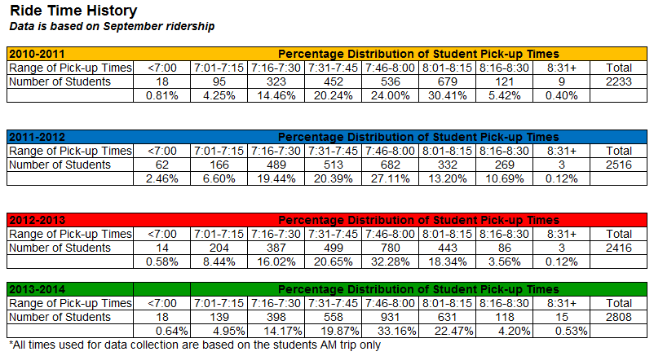
GYPSD Ride Times

Slide 21
Communication: the TCCAP is released to communities on an ongoing basis using newspaper, radio and other promotional items distributed through Transportation Services and schools. Regular updates are available on the GYPSD website including current and proposed school bus routes.
The Director of Transportation will continue to monitor bus loads, ride times and waiting lists of students. Route concerns reported to Transportation Services will continue to be documented, reviewed and resolved in an ongoing fashion.
Grande Yellowhead Public School Division believes that all concerns be addressed in order to provide our students with a safe environment, on and off the school bus. Parents, schools and other interested stakeholders are encouraged to communicate their concerns to the Transportation office as soon as possible.

